Slide 1

Introduction to JavaScript

Slide 2
Agenda
What is JavaScript
Features of JavaScript
How to JavaScript
JavaScript Programming
JavaScript Objects
HTML DOM Objects
DOM Events
JSON
AJAX

Slide 3
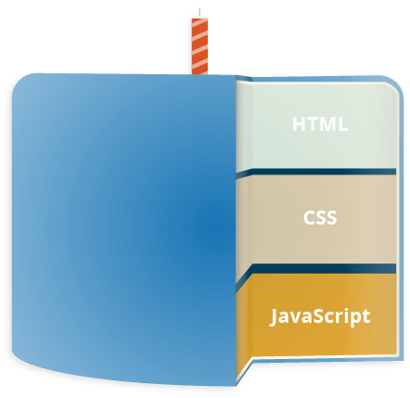
What is JavaScript?
JavaScript is a scripting language widely used for client-side web development
Notes:
ภาษาจาวาสคริปต์ คือ ภาษาโปรแกรมคล้ายภาษาซี ถูกใช้ร่วมกับภาษาเอชทีเอ็มแอลในการพัฒนาเว็บเพจ ประมวลผลในเครื่องของผู้ใช้ ช่วยให้การนำเสนอเป็นแบบโต้ตอบกับผู้ใช้ได้ในระดับหนึ่ง
ภาษาจาวาสคริปต์ (JavaScript Language) คือ ภาษาโปรแกรมที่มีโครงสร้างคล้ายภาษาซี ทำหน้าที่แปลความหมาย และดำเนินการทีละคำสั่ง ภาษานี้มีชื่อเดิมว่า LiveScript ถูกพัฒนาโดย Netscape Navigator เพื่อช่วยให้เว็บเพจสามารถแสดงเนื้อหา ที่มีการเปลี่ยนแปลงได้ ตามเงื่อนไข หรือสภาพแวดล้อมที่แตกต่างกัน หรือโต้ตอบกับผู้ใช้ได้มากขึ้น เพราะภาษา HTML ที่เป็นภาษาพื้นฐานของเว็บเพจ ทำได้เพียงแสดงข้อมูลแบบคงที่ (Static Display)

Slide 4
What can a JavaScript Do?
Java Script gives HTML designers a programming tool
Java Script can put dynamic text into an HTML page
Java Script can read and write HTML elements
Java Script can react to events
Java Script can calculate, manipulate and validate data

Slide 5
JavaScript in Web pages
JavaScript code can run locally in a user's browser it can respond to user actions quickly, making an application feel more responsive
A JavaScript engine (also known as JavaScript interpreter or JavaScript implementation) is an interpreter that interprets JavaScript source code and executes the script accordingly

Slide 6
JavaScript Security
JavaScript and the DOM provide the potential for malicious authors to deliver scripts to run on a client computer via the web
Scripts run in a sandbox in which they can only perform web-related actions, not general-purpose programming tasks like creating files
Scripts are constrained by the same origin policy

Slide 7
Features of JavaScript
Imperative and structured
JavaScript supports all the structured programming syntax in C
if - switch statement, for - while loop, etc.
Dynamic
Dynamic typing
JavaScript supports various ways to test the type of an object
Objects as associative arrays
The properties of an object can also be enumerated via a for...in loop
Run-time evaluation
an eval function can execute statements provided as strings at run-time

Slide 8
Features of JavaScript
Functional
First-class functions
Function have properties and can be passed around and interacted with like any other object
Inner functions and closures
Inner functions are created each time the outer function is invoked, and variables of the outer functions for that invocation continue to exist as long as the inner functions still exist, even after that invocation is finished

Slide 9
Features of JavaScript
Prototype-based
Prototypes
JavaScript uses prototypes instead of classes for defining object properties, including methods, and inheritance.
Functions as object constructors
Functions double as object constructors along with their typical role
Prefixing a function call with new creates a new object and calls that function with its local this keyword bound to that object for that invocation
Functions as methods
A function can be called as a method

Slide 10
Features of JavaScript
Miscellaneous
Run-time environment
JavaScript typically relies on a run-time environment (in a web browser) to provide objects and methods by which scripts can interact with "the outside world"
Variadic functions
An indefinite number of parameters can be passed to a function. The function can both access them through formal parameters and the local arguments object
Array and object literals
Arrays and objects can each be created with a succinct shortcut syntax, literals form the basis of the JSON data format
Regular expressions
JavaScript also supports regular expressions in a manner similar to Perl, which provide a concise and powerful syntax for text manipulation that is more sophisticated than the built-in string functions

Slide 11
How To JavaScript
Getting Started
To embed JavaScript code in an HTML document, it must be preceded with
<script type="text/javascript">
//<![CDATA[
...
//]]>
</script>
<script>
…
</script>
1
2
<script language="JavaScript" type="text/javascript">
<!–
...
// -->
</script>
3
<script src="../path-to/source.js"></script>
4

Slide 12
How To JavaScript
Hello World
<HTML>
<HEAD>
<TITLE>Hello World</TITLE>
<script>
document.write("Hello World");
</script>
</HEAD>
<BODY>
</BODY>
</HTML>

Slide 13
JavaScript Programming
White Space
space, tab , newline
Comment
// comment on one line
/* comment one or more lines */
Separators
() arguments, parameters
{} array assignment, block
[] array definition & index
; terminate statement
, declaration, for-loop definition

Slide 14
Reserve Word
abstract | else | instanceof | switch
boolean | enum | int | synchronized
break | export | interface | this
byte | extends | long | throw
case | false | native | throws
catch | final | new | transient
char | finally | null | true
class | float | package | try
const | for | private | typeof
continue | function | protected | var
debugger | goto | public | void
default | if | return | volatile
delete | implements | short | while
do | import | static | with
double | in | super
14
14

Slide 15
Variables
Variables must conform
No conflict with reserve words
Case sensitive
They must start with a letter or underscore ("_")
Subsequent characters can also be digits (0-9) or letters (A-Z and/or a-z).
var myVar;
var MyVar = “String”;
var _myVar = true;
var myVar1 = null;
var x = 1, y = ‘Hello’, z = false;
Notes:
In JavaScript, a variable can be declared after it has been used.
In other words; a variable can be used before it has been declared.
x = 5; // Assign 5 to x … var x; // Declare x
To avoid bugs, always declare all variables at the beginning of every scope

Slide 16
Data Type Conversion
Dynamic Typing
JavaScript is a loosely typed language
The + sign tells JavaScript to concatenate or stick together
var x = 10;
…
x = “Hello World”;
var x = "The answer is " + 42;
var y = 42 + " is the answer";
var msg = "Hello" + "World";

Slide 17
Literals
Integer
decimal (base 10) ex. 12;
octal (base 8) ex. 012;
hexadecimal (base 16) ex. 0x12;
Floating-point
standard ex. 0.123
science ex. 0.123E-1
Boolean
true , false

Slide 18
Literals
String
A string literal is zero or more characters enclosed in double (") or single (') quotation marks
"blah"
'blah'
"1234"
"one line \n another line"

Slide 19
Literals
Escape Characters
Character | Meaning
\b | backspace
\f | form feed
\n | new line
\r | carriage return
\t | tab
\\ | backslash character
var quote = “I read \”Ajax in Practice\” by Dave Crane”
var home = “c:\\temp”

Slide 20
Operator
Arithmetic Operator
+ , - , * , / , % , ++ , --
Assignment Operator
Shorthand operator | Meaning
x = y | assign
x += y | x = x + y
x -= y | x = x - y
x *= y | x = x * y
x /= y | x = x / y
x%=y | x = x%y

Slide 21
Operator
Comparison Operator
Operator | Description | Example
Equal (= =) | Evaluates to true if the operands are equal. | x == y evaluates to true if x equals y.
Not equal (!=) | Evaluates to true if the operands are not equal. | x != y evaluates to true if x is not equal to y.
Greater than (>) | Evaluates to true if left operand is greater than right operand. | x > y evaluates to true if x is greater than y.
Greater than or equal (>=) | Evaluates to true if left operand is greater than or equal to right operand. | x >= y evaluates to true if x is greater than or equal to y.
Less than (<) | Evaluates to true if left operand is less than right operand. | x < y evaluates to true if x is less than y.
Less than or equal (<=) | Evaluates to true if left operand is less than or equal to right operand. | x <= y evaluates to true if x is less than or equal to y.

Slide 22
Operator
Logical Operator
Operator | Usage | Description
and (&&) | expr1 && expr2 | True if both logical expressions expr1 and expr2 are true. False otherwise.
or (||) | expr1 || expr2 | True if either logical expression expr1 or expr2 is true. False if both expr1 and expr2 are false.
not (!) | !expr | False if expr is true; true if expr is false.

Slide 23
Operator
Ternary Operator
Expression ? X : Y
a = (1>0) ? true : false;
b = (x % 2 == 0) ? “even” : “odd”;

Slide 24
Operator
Precedence of Operator
Priority | Operator
1 | ()
2 | /
3 | *
4 | %
5 | +/-
6 | &&
7 | ||
8 | +=, -=, /=, %=
a = 2 * 100 / 10; => 20
//2 * (100 / 10)
b = 100 / 10 % 2; => 0
//(100/10) % 2
c = 100/10 + 30; => 40
//(100/10) + 30
d = 2*100/10+30; => 50
//2*(100/10))+30

Slide 25
Control Statement
if/else statement
if (condition) {
statements1
}
if (condition) {
statements1
}
else {
statements2
}

Slide 26
Control Statement
Dangling Else
if (condition1) if (condition2) statement1; else statement2;
1.
2.
if (condition1)
if (condition2)
statement1
else
statement2
if (condition1)
if (condition2)
statement1
else
statement2

Slide 27
Control Statement
switch statement
switch (expression) {
case value1 :
statements1
break;
case value2 :
statements2;
break;
…
default :
default-statement;
break;
}

Slide 28
Loops
for loop
for …in loop
for (initial-expression; condition; increment-expression) {
statements
}
for (variable in object) {
statements
}

Slide 29
Loops
while loop
do … while loop
while (condition) {
statements
}
do {
statements
}while (condition);

Slide 30
Function
A function is a JavaScript procedure
A function definition has these basic parts
The function keyword
A function name
A comma-separated list of arguments to the function in parentheses
The statements in the function in curly braces: { }

Slide 31
Function
Defining Function
function functionname(var1,var2,...,var n) {
statements;
result = statements;
return result;
}
1
var functionname = function(var1,var2,...,var n) {
statements
}
2
function helloWorld() {
document.write(‘Hello World’);
}
function prod(a,b) {
x=a*b;
return x;
}
var hello = function(msg) {
document.write(“Hello “+msg);
}

Slide 32
Function
Calling Function
<button onclick=”helloWorld()”>Hello</button>
function anotherHello() {
helloWorld();
hello(“World”);
product = prod(4,5);
}
function multiply() {
document.write(“result=“+prod(5,10));
}

Slide 33
Function
Functions as Methods
function inc(x) {
return ++x;
}
var obj = {};
obj.sqrt = function(x) { return x*x; }
obj.increment = inc;
document.write(obj.sqrt(10));
document.write(obj.increment(9));

Slide 34
Function
Variadic Function
<html>
<head>
<title>Arguments</title>
<script language="JavaScript">
function play() {
for(var i=0;i<arguments.length;i++) {
alert(play.arguments[i]);
}
}
</script>
</head>
<body>
<button onclick="play(1,2,3)">Play 1</button>
<button onclick="play('hello','world')">Play 2</button>
</body>
</html>

Slide 35
Exception Handling
Catching Errors
By using the try...catch statement
<html>
<head>
<title>Try Catch</title>
<script language="JavaScript">
function test() {
try {
addAlert("Welcome guest!");
} catch(ex) {
txt="There was an error on this page.\n\n";
txt+="Error description: " + ex.description + "\n\n";
txt+="Click OK to continue.\n\n";
alert(txt);
}
}
</script>
</head>
<body>
<button onclick="test()">Test</button>
</body>
</html>

Slide 36
Exception Handling
Catching Errors
By using the onerror event
<html>
<head>
<title>On Error</title>
<script type="text/javascript">
onerror=handleError;
function handleError(msg,url,l) {
var txt="There was an error on this page.\n\n";
txt+="Error: " + msg + "\n";
txt+="URL: " + url + "\n";
txt+="Line: " + l + "\n\n";
txt+="Click OK to continue.\n\n";
alert(txt);
return true;
}
function test() { addAlert("Welcome guest!"); }
</script>
</head>
<body>
<button onclick="test()">Test</button>
</body>
</html>

Slide 37
Object
Creating Object
Object as associative array
personObj = new Object();
personObj.firstname="Tassun";
personObj.lastname="Oros";
personObj.address="Pakkred";
personObj = new Object();
personObj["firstname"]="Tassun";
personObj["lastname"]="Oros";
personObj["address"]="Pakkred";

Slide 38
Object
Creating Object
function display(person) {
for(var p in person) { document.write(p+"="+person[p]+"<br>");
}
}
function test() {
{
personObj = new Object();
personObj.firstname="Tassun";
personObj.lastname="Oros";
personObj.address="Pakkred";
display(personObj);
}
{
personObj = new Object();
personObj["firstname"]="Tassun";
personObj["lastname"]="Oros";
personObj["address"]="Pakkred";
display(personObj);
}
}

Slide 39
Object
Creating Object
Create a template of an object
Function as an object constructor
function Person(firstname,lastname,address) {
this.firstname=firstname;
this.lastname=lastname;
this.address=address;
}
var tso = new Person(“Tassun",“Oros",”Pakkred");

Slide 40
Closure
Inner Function
personObj = new Object();
personObj.firstname="Tassun";
personObj.lastname="Oros";
personObj.address="Pakkred";
personObj.setup = function() {
var msg = "Hello ";
this.sayHi = function() {
alert(msg+" : "+this.firstname);
}
}
personObj.setup();
personObj.sayHi();

Slide 41
Prototype
Wrap up an object function
function Person(firstname,lastname,address) {
this.firstname=firstname;
this.lastname=lastname;
this.address=address;
this.getFullName = function() {
return this.firstname+" "+this.lastname;
}
}
function Person(firstname,lastname,address) {
this.firstname=firstname;
this.lastname=lastname;
this.address=address;
}
Person.prototype.getFullName = function() {
return this.firstname+" "+this.lastname;
}
Person.prototype.HELLO_MESSAGE = "Hello";
Person.prototype.sayHi = function() {
alert(this.HELLO_MESSAGE+" : "+this.firstname);
}

Slide 42
Array
Array Declaration
<html>
<head>
<title>Array</title>
<script language="JavaScript">
var ary1 = new Array();
ary1[0] = 'A';
ary1[2] = 10;
var ary2 = ['1','2','3'];
var ary3 = new Array(5);
var ary4 = new Array("Sun","Mon","Tue","Wed","Thu","Fri","Sat");
function test() {
for(var i=0;i<ary1.length;i++) {
alert(ary1[i]);
}
for(var x in ary4) {
alert(ary4[x]);
}
}
</script>
</head>
<body>
<button onclick="test()">Test</button>
</body>
</html>

Slide 43
Array
Array Object Methods
Method | Description
concat() | Joins two or more arrays and returns the result
join() | Puts all the elements of an array into a string. The elements are separated by a specified delimiter
pop() | Removes and returns the last element of an array
push() | Adds one or more elements to the end of an array and returns the new length
reverse() | Reverses the order of the elements in an array
shift() | Removes and returns the first element of an array
slice() | Returns selected elements from an existing array
sort() | Sorts the elements of an array
splice() | Removes and adds new elements to an array
toSource() | Represents the source code of an object
toString() | Converts an array to a string and returns the result
unshift() | Adds one or more elements to the beginning of an array and returns the new length
valueOf() | Returns the primitive value of an Array object

Slide 44
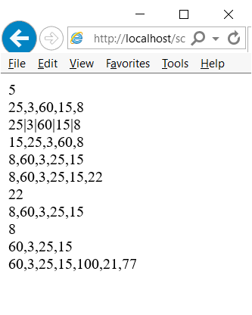
Array
<html>
<head>
<title>Array</title>
<script language="JavaScript">
var ary1 = [25,3,60,15, 8];
var ary2 = [100,21,77];
function test() {
document.write(ary1.length);
document.write("<br>");
document.write(ary1.toString());
document.write("<br>");
document.write(ary1.join("|"));
document.write("<br>");
document.write(ary1.sort());
document.write("<br>");
document.write(ary1.reverse());
document.write("<br>");
ary1.push(22);
document.write(ary1);
var a = ary1.pop();
document.write("<br>"+a+"<br>");
document.write(ary1);
var b = ary1.shift();
document.write("<br>"+b+"<br>");
document.write(ary1);
document.write("<br>");
document.write(ary1.concat(ary2));
}
</script>
</head>
<body>
<button onclick="test()">Test</button>
</body>
</html>
Example

Slide 45
JavaScript Function
Top-level Functions
Function | Description
escape() | Encodes a string
eval() | Evaluates a string and executes it as if it was script code
isFinite() | Checks if a value is a finite number
isNaN() | Checks if a value is not a number
Number() | Converts an object's value to a number
parseFloat() | Parses a string and returns a floating point number
parseInt() | Parses a string and returns an integer
String() | Converts an object's value to a string
unescape() | Decodes a string encoded by escape()

Slide 46
JavaScript Function
eval Function
<html>
<head>
<title>eval</title>
<script language="JavaScript">
function hello(msg) { logger.innerHTML = logger.innerHTML+'<br>Hello : '+msg; }
function evalClick() {
logger.innerHTML = "Value is : "+eval(myval.value)*10;
}
function helloClick() {
var fn = eval("hello");
fn(myval.value);
}
function greetClick() {
greet(myval.value);
}
eval("function greet(msg) { logger.innerHTML = logger.innerHTML+'<br>Greet : '+msg; }");
</script>
</head>
<body>
<input type="text" id="myval"></input>
<button onclick="evalClick()">Eval</button>
<button onclick="helloClick()">Hello</button>
<button onclick="greetClick()">Greet</button>
<div id="logger"></div>
</body>
</html>

Slide 47
JavaScript Objects
String Object
Method | Description
charAt() | Returns the character at a specified position
charCodeAt() | Returns the Unicode of the character at a specified position
concat() | Joins two or more strings
fromCharCode() | Takes the specified Unicode values and returns a string
indexOf() | Returns the position of the first occurrence of a specified string value in a string
lastIndexOf() | Returns the position of the last occurrence of a specified string value, searching backwards from the specified position in a string
match() | Searches for a specified value in a string
replace() | Replaces some characters with some other characters in a string
search() | Searches a string for a specified value
slice() | Extracts a part of a string and returns the extracted part in a new string
split() | Splits a string into an array of strings
substr() | Extracts a specified number of characters in a string, from a start index
substring() | Extracts the characters in a string between two specified indices
toLowerCase() | Displays a string in lowercase letters
toUpperCase() | Displays a string in uppercase letters
valueOf() | Returns the primitive value of a String object

Slide 48
JavaScript Objects
Date Object
Method | Description
Date() | Returns today's date and time
getDate() | Returns the day of the month from a Date object (from 1-31)
getDay() | Returns the day of the week from a Date object (from 0-6)
getFullYear() | Returns the year, as a four-digit number, from a Date object
getHours() | Returns the hour of a Date object (from 0-23)
getMilliseconds() | Returns the milliseconds of a Date object (from 0-999)
getMinutes() | Returns the minutes of a Date object (from 0-59)
getMonth() | Returns the month from a Date object (from 0-11)
getSeconds() | Returns the seconds of a Date object (from 0-59)
getTime() | Returns the number of milliseconds since midnight Jan 1, 1970
getTimezoneOffset() | Returns the difference in minutes between local time and Greenwich Mean Time (GMT)
getUTCDate() | Returns the day of the month from a Date object according to universal time (from 1-31)
getUTCDay() | Returns the day of the week from a Date object according to universal time (from 0-6)
getUTCMonth() | Returns the month from a Date object according to universal time (from 0-11)
getUTCFullYear() | Returns the four-digit year from a Date object according to universal time
getUTCHours() | Returns the hour of a Date object according to universal time (from 0-23)
getUTCMinutes() | Returns the minutes of a Date object according to universal time (from 0-59)

Slide 49
JavaScript Objects
Date Object
Method | Description
getUTCSeconds() | Returns the seconds of a Date object according to universal time (from 0-59)
getUTCMilliseconds() | Returns the milliseconds of a Date object according to universal time (from 0-999)
getYear() | Returns the year, as a two-digit or a three/four-digit number, depending on the browser. Use getFullYear() instead !!
parse() | Takes a date string and returns the number of milliseconds since midnight of January 1, 1970
setDate() | Sets the day of the month in a Date object (from 1-31)
setFullYear() | Sets the year in a Date object (four digits)
setHours() | Sets the hour in a Date object (from 0-23)
setMilliseconds() | Sets the milliseconds in a Date object (from 0-999)
setMinutes() | Set the minutes in a Date object (from 0-59)
setMonth() | Sets the month in a Date object (from 0-11)
setSeconds() | Sets the seconds in a Date object (from 0-59)
setTime() | Calculates a date and time by adding or subtracting a specified number of milliseconds to/from midnight January 1, 1970
setUTCDate() | Sets the day of the month in a Date object according to universal time (from 1-31)
setUTCMonth() | Sets the month in a Date object according to universal time (from 0-11)
setUTCFullYear() | Sets the year in a Date object according to universal time (four digits)

Slide 50
JavaScript Objects
Date Object
Method | Description
setUTCHours() | Sets the hour in a Date object according to universal time (from 0-23)
setUTCMinutes() | Set the minutes in a Date object according to universal time (from 0-59)
setUTCSeconds() | Set the seconds in a Date object according to universal time (from 0-59)
setUTCMilliseconds() | Sets the milliseconds in a Date object according to universal time (from 0-999)
setYear() | Sets the year in the Date object (two or four digits). Use setFullYear() instead !!
toDateString() | Returns the date portion of a Date object in readable form
toGMTString() | Converts a Date object, according to Greenwich time, to a string. Use toUTCString() instead !!
toLocaleDateString() | Converts a Date object, according to local time, to a string and returns the date portion
toLocaleTimeString() | Converts a Date object, according to local time, to a string and returns the time portion
toLocaleString() | Converts a Date object, according to local time, to a string
toSource() | Represents the source code of an object
toString() | Converts a Date object to a string
toTimeString() | Returns the time portion of a Date object in readable form
toUTCString() | Converts a Date object, according to universal time, to a string
UTC() | Takes a date and returns the number of milliseconds since midnight of January 1, 1970 according to universal time
valueOf() | Returns the primitive value of a Date object

Slide 51
JavaScript Objects
Math Object
Property | Description
E | Returns Euler's constant (approx. 2.718)
LN2 | Returns the natural logarithm of 2 (approx. 0.693)
LN10 | Returns the natural logarithm of 10 (approx. 2.302)
LOG2E | Returns the base-2 logarithm of E (approx. 1.442)
LOG10E | Returns the base-10 logarithm of E (approx. 0.434)
PI | Returns PI (approx. 3.14159)
SQRT1_2 | Returns the square root of 1/2 (approx. 0.707)
SQRT2 | Returns the square root of 2 (approx. 1.414)

Slide 52
JavaScript Objects
Math Object
Method | Description
abs(x) | Returns the absolute value of a number
acos(x) | Returns the arccosine of a number
asin(x) | Returns the arcsine of a number
atan(x) | Returns the arctangent of x as a numeric value between -PI/2 and PI/2 radians
atan2(y,x) | Returns the angle theta of an (x,y) point as a numeric value between -PI and PI radians
ceil(x) | Returns the value of a number rounded upwards to the nearest integer
cos(x) | Returns the cosine of a number
exp(x) | Returns the value of E^{x}
floor(x) | Returns the value of a number rounded downwards to the nearest integer
log(x) | Returns the natural logarithm (base E) of a number
max(x,y) | Returns the number with the highest value of x and y
min(x,y) | Returns the number with the lowest value of x and y
pow(x,y) | Returns the value of x to the power of y
random() | Returns a random number between 0 and 1
round(x) | Rounds a number to the nearest integer
sin(x) | Returns the sine of a number
sqrt(x) | Returns the square root of a number
tan(x) | Returns the tangent of an angle

Slide 53
JavaScript Objects
RegExp Object
The regular expression object describes a pattern of characters
pattern specifies the pattern of the regular expression
attributes specifies global ("g"), case-insensitive ("i"), and multiline matches ("m")
var txt=new RegExp(pattern,attributes);
var txt=/pattern/attributes;

Slide 54
JavaScript Objects
RegExp Modifiers - Position Matching
Modifier | Description
^ | Get a match at the beginning of a string
$ | Get a match at the end of a string
\b | Word boundary. Get a match at the beginning or end of a word in the string
\B | Non-word boundary. Get a match when it is not at the beginning or end of a word in the string
?= | A positive look ahead. Get a match if a string is followed by a specific string
?! | A negative look ahead. Get a match if a string is not followed by a specific string

Slide 55
JavaScript Objects
RegExp Modifiers - Character Classes
Modifier | Description
[xyz] | Find any character in the specified character set
[^xyz] | Find any character not in the specified character set
. (dot) | Find any character except newline or line terminator
\w | Find any alphanumeric character including the underscore
\W | Find any non-word character
\d | Find any single digit
\D | Find any non-digit
\s | Find any single space character
\S | Find any single non-space character

Slide 56
JavaScript Objects
RegExp Modifiers - Repetition
Modifier | Description
{x} | Finds the exact (x) number of the regular expression grouped together
{x,} | Finds the exact (x) or more number of the regular expression grouped together
{x,y} | Finds between x and y number of the regular expression grouped together
? | Finds zero or one occurrence of the regular expression
* | Finds zero or more occurrences of the regular expression
+ | Finds one or more occurrences of the regular expression

Slide 57
JavaScript Objects
Example – format date
function formatDateTime(time,includeDate) {
if(!time) return "";
var result = "";
var now;
if(time instanceof Date) now = time;
else now = new Date(eval(time));
if(includeDate) {
var dd = now.getDate();
var mm = now.getMonth()+1;
var yy = now.getFullYear();
result += ((dd < 10) ? "0" : "") + dd;
result += ((mm < 10) ? "/0" : "/") + mm;
result += "/"+yy;
result += " ";
}
var hh = now.getHours();
var mm = now.getMinutes();
var ss = now.getSeconds();
result += ((hh < 10) ? "0":"") + hh;
result += ((mm < 10) ? ":0" : ":") + mm;
result += ((ss < 10) ? ":0" : ":") + ss;
return result;
}

Slide 58
JavaScript Objects
Example – check date
function isDate(mydate){
if (mydate=="" || mydate == null) return true;
if ( checkDate(mydate) ) return true;
return false;
}
function checkDate(mydate) {
var delimiter = "/";
var dmy = /\d{1,2}\/\d{1,2}\/\d{2,4}/ ;
if ( !mydate.match(dmy) ) { alert("Invalid date's format"); return false;}
var intDay = new Date();
var ary_date = mydate.split(delimiter);
// ------ check year
var y=ary_date[2];
if ( y.length==2 ) {
if (y>=80) { y = intDay.getYear()-100-(intDay.getYear()%100)+eval(y) ; }
else { y = intDay.getYear()-(intDay.getYear()%100)+ eval(y) ;} }
else if ( y.length==3 ) { alert("Invalid year."); return false; }
intDay.setYear(y);
// ------ check month
var m = eval(ary_date[1]) ;
if ( (m>0) && (m<=12) ) { intDay.setMonth(m); intDay.setDate(0); }
else { alert("Invalid month"); return false ;}
// ------ check day
var d = eval(ary_date[0]);
if ( (d>0) && (d<=intDay.getDate()) ) { return true; }
else { alert("Invalid date"); return false; }
}

Slide 59
User Interaction
Alert dialog box
alert(“Hello World”);
Confirm dialog box
var reply = confirm(“Close?”);
Prompt dialog box
var result = prompt(“Input”,”default”);
Status bar
window.status = “Hello World”;

Slide 60
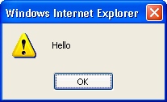
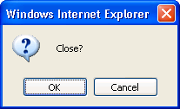
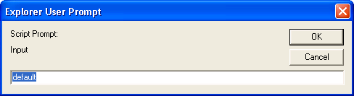
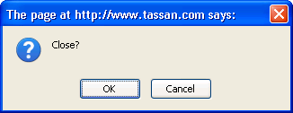
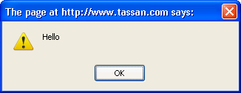
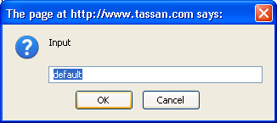
User Interaction
IE
FireFox

Slide 61
HTML DOM
More JavaScript Objects
Object | Description
Window | The top level object in the JavaScript hierarchy. The Window object represents a browser window. A Window object is created automatically with every instance of a <body> or <frameset> tag
Navigator | Contains information about the client's browser
Screen | Contains information about the client's display screen
History | Contains the visited URLs in the browser window
Location | Contains information about the current URL

Slide 62
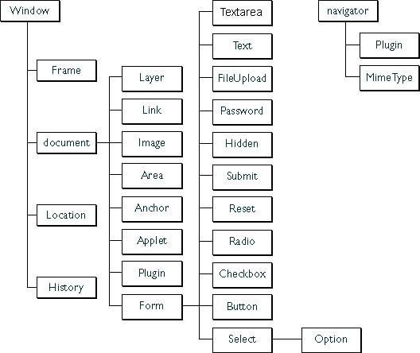
DOM Tree
DOM (Document Object Model)

Slide 63
Window Object
Properties
Property | Description
closed | Returns whether or not a window has been closed
defaultStatus | Sets or returns the default text in the statusbar of the window
document | See Document object
history | See History object
length | Sets or returns the number of frames in the window
location | See Location object
name | Sets or returns the name of the window
opener | Returns a reference to the window that created the window
outerHeight | Sets or returns the outer height of a window
outerWidth | Sets or returns the outer width of a window
pageXOffset | Sets or returns the X position of the current page in relation to the upper left corner of a window's display area
pageYOffset | Sets or returns the Y position of the current page in relation to the upper left corner of a window's display area
parent | Returns the parent window

Slide 64
Window Object
Properties
Property | Description
personalbar | Sets whether or not the browser's personal bar (or directories bar) should be visible
scrollbars | Sets whether or not the scrollbars should be visible
self | Returns a reference to the current window
status | Sets the text in the statusbar of a window
statusbar | Sets whether or not the browser's statusbar should be visible
toolbar | Sets whether or not the browser's tool bar is visible or not (can only be set before the window is opened and you must have UniversalBrowserWrite privilege)
top | Returns the topmost ancestor window

Slide 65
Window Object
Methods
Method | Description
alert() | Displays an alert box with a message and an OK button
blur() | Removes focus from the current window
clearInterval() | Cancels a timeout set with setInterval()
clearTimeout() | Cancels a timeout set with setTimeout()
close() | Closes the current window
confirm() | Displays a dialog box with a message and an OK and a Cancel button
createPopup() | Creates a pop-up window
focus() | Sets focus to the current window
moveBy() | Moves a window relative to its current position
moveTo() | Moves a window to the specified position
open() | Opens a new browser window
print() | Prints the contents of the current window
prompt() | Displays a dialog box that prompts the user for input
resizeBy() | Resizes a window by the specified pixels

Slide 66
Window Object
Methods
Method | Description
resizeTo() | Resizes a window to the specified width and height
scrollBy() | Scrolls the content by the specified number of pixels
scrollTo() | Scrolls the content to the specified coordinates
setInterval() | Evaluates an expression at specified intervals
setTimeout() | Evaluates an expression after a specified number of milliseconds

Slide 67
Window Object
Open New Window
window.open(URL,name,specs,replace)
Parameter | Description
URL | Optional. Specifies the URL of the page to open. If no URL is specified, a new window with about:blank is opened
name | Optional. Specifies the target attribute or the name of the window. The following values are supported: _blank - URL is loaded into a new window. This is default _parent - URL is loaded into the parent frame _self - URL replaces the current page _top - URL replaces any framesets that may be loaded name - The name of the window
specs | Optional. A comma-separated list of items. The following values are supported:
replace | Optional.Specifies whether the URL creates a new entry or replaces the current entry in the history list. The following values are supported: true - URL replaces the current document in the history list false - URL creates a new entry in the history list

Slide 68
Window Object
Open New Window
Specs or Options
channelmode=yes|no|1|0 | Whether or not to display the window in theater mode. Default is no
directories=yes|no|1|0 | Whether or not to add directory buttons. Default is yes
fullscreen=yes|no|1|0 | Whether or not to display the browser in full-screen mode. Default is no. A window in full-screen mode must also be in theater mode
height=pixels | The height of the window. Min. value is 100
left=pixels | The left position of the window
location=yes|no|1|0 | Whether or not to display the address field. Default is yes
menubar=yes|no|1|0 | Whether or not to display the menu bar. Default is yes
resizable=yes|no|1|0 | Whether or not the window is resizable. Default is yes
scrollbars=yes|no|1|0 | Whether or not to display scroll bars. Default is yes
status=yes|no|1|0 | Whether or not to add a status bar. Default is yes
titlebar=yes|no|1|0 | Whether or not to display the title bar. Ignored unless the calling application is an HTML Application or a trusted dialog box. Default is yes
toolbar=yes|no|1|0 | Whether or not to display the browser toolbar. Default is yes
top=pixels | The top position of the window
width=pixels | The width of the window. Min. value is 100

Slide 69
Navigator Object
Properties
Property | Description
appCodeName | Returns the code name of the browser
appMinorVersion | Returns the minor version of the browser
appName | Returns the name of the browser
appVersion | Returns the platform and version of the browser
browserLanguage | Returns the current browser language
cookieEnabled | Returns a Boolean value that specifies whether cookies are enabled in the browser
cpuClass | Returns the CPU class of the browser's system
onLine | Returns a Boolean value that specifies whether the system is in offline mode
platform | Returns the operating system platform
systemLanguage | Returns the default language used by the OS
userAgent | Returns the value of the user-agent header sent by the client to the server
userLanguage | Returns the OS' natural language setting

Slide 70
Navigator Object
Browser Detection
<html>
<body>
<script type="text/javascript">
var x = navigator;
document.write("CodeName=" + x.appCodeName);
document.write("<br />");
document.write("MinorVersion=" + x.appMinorVersion);
document.write("<br />");
document.write("Name=" + x.appName);
document.write("<br />");
document.write("Version=" + x.appVersion);
document.write("<br />");
document.write("CookieEnabled=" + x.cookieEnabled);
document.write("<br />");
document.write("CPUClass=" + x.cpuClass);
document.write("<br />");
document.write("OnLine=" + x.onLine);
document.write("<br />");
document.write("Platform=" + x.platform);
document.write("<br />");
document.write("UA=" + x.userAgent);
document.write("<br />");
document.write("BrowserLanguage=" + x.browserLanguage);
document.write("<br />");
document.write("SystemLanguage=" + x.systemLanguage);
document.write("<br />");
document.write("UserLanguage=" + x.userLanguage);
</script>
</body></html>

Slide 71
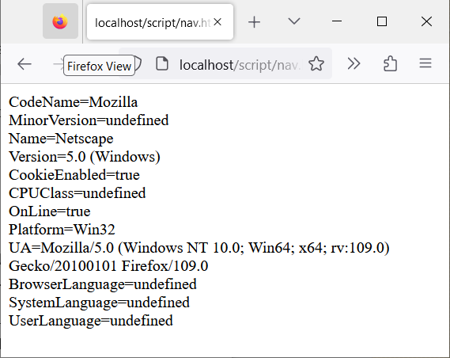
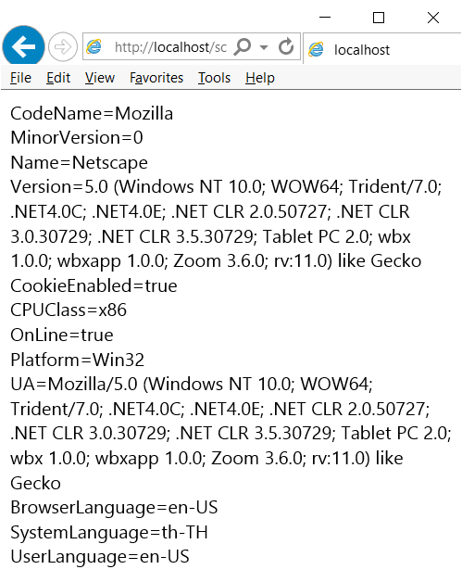
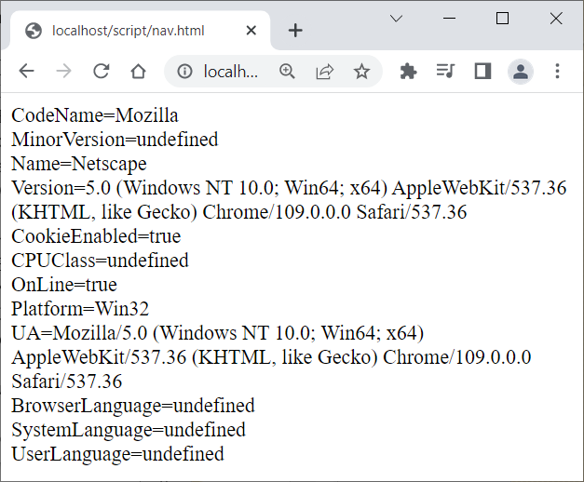
Navigator Object
Browser Detection

Slide 72
Screen Object
Properties
Property | Description
availHeight | Returns the height of the display screen (excluding the Windows Taskbar)
availWidth | Returns the width of the display screen (excluding the Windows Taskbar)
bufferDepth | Sets or returns the bit depth of the color palette in the off-screen bitmap buffer
colorDepth | Returns the bit depth of the color palette on the destination device or buffer
deviceXDPI | Returns the number of horizontal dots per inch of the display screen
deviceYDPI | Returns the number of vertical dots per inch of the display screen
fontSmoothingEnabled | Returns whether the user has enabled font smoothing in the display control panel
height | The height of the display screen
logicalXDPI | Returns the normal number of horizontal dots per inch of the display screen
logicalYDPI | Returns the normal number of vertical dots per inch of the display screen
pixelDepth | Returns the color resolution (in bits per pixel) of the display screen
updateInterval | Sets or returns the update interval for the screen
width | Returns width of the display screen

Slide 73
History Object
Properties
Methods
Property | Description
length | Returns the number of elements in the history list
Method | Description
back() | Loads the previous URL in the history list
forward() | Loads the next URL in the history list
go() | Loads a specific page in the history list

Slide 74
Location Object
Properties & Methods
Property | Description
hash | Sets or returns the URL from the hash sign (#)
host | Sets or returns the hostname and port number of the current URL
hostname | Sets or returns the hostname of the current URL
href | Sets or returns the entire URL
pathname | Sets or returns the path of the current URL
port | Sets or returns the port number of the current URL
protocol | Sets or returns the protocol of the current URL
search | Sets or returns the URL from the question mark (?)
Method | Description
assign() | Loads a new document
reload() | Reloads the current document
replace() | Replaces the current document with a new one

Slide 75
Document Object
Properties
Property | Description
body | Gives direct access to the <body> element
cookie | Sets or returns all cookies associated with the current document
domain | Returns the domain name for the current document
lastModified | Returns the date and time a document was last modified
referrer | Returns the URL of the document that loaded the current document
title | Returns the title of the current document
URL | Returns the URL of the current document

Slide 76
Document Object
Methods
Method | Description
close() | Closes an output stream opened with the document.open() method, and displays the collected data
getElementById() | Returns a reference to the first object with the specified id
getElementsByName() | Returns a collection of objects with the specified name
getElementsByTagName() | Returns a collection of objects with the specified tagname
open() | Opens a stream to collect the output from any document.write() or document.writeln() methods
write() | Writes HTML expressions or JavaScript code to a document
writeln() | Identical to the write() method, with the addition of writing a new line character after each expression

Slide 77
DOM Events
DOM (Document Object Model) events allow event-driven programming languages to register various event handlers/listeners on the element nodes inside a DOM tree

Slide 78
Event Handling
Event Model
DOM Level 0
Inline model
Traditional model
DOM Level 2
Microsoft-specific model

Slide 79
Event Handling
DOM Level 0
Inline model
the inline model, event handlers are added as attribute of element
<html>
<head>
<script type="text/javascript">
function helloWorld( name )
{
window.alert( "Hello " + name );
}
function removeHandler(object)
{
object.onclick = null;
}
</script>
</head>
<body>
<button onclick="helloWorld('Joe'); removeHandler(this);">Hello</button>
</body>
<html>

Slide 80
Event Handling
DOM Level 0
Traditional model
the traditional model, event handlers can be added/removed by scripts
<html>
<head>
<script type="text/javascript">
function helloWorld() {
window.alert( "Hello World" );
// Remove the event handler just added
helloButton.onclick = null;
}
window.onload = function() {
// Add an event handler
helloButton.onclick = helloWorld;
}
</script>
</head>
<body>
<button id="helloButton">Hello</button>
</body>
</html>

Slide 81
Event Handling
DOM Level 2
Name | Description | Argument type | Argument name
addEventListener | Allows the registration of event listeners on the event target. | DOMString | type
 |  | EventListener | listener
 |  | boolean | useCapture
removeEventListener | Allows the removal of event listeners from the event target. | DOMString | type
 |  | EventListener | listener
 |  | boolean | useCapture
dispatchEvent | Allows to send the event to the subscribed event listeners. | Event | evt

Slide 82
Event Handling
DOM Level 2
To prevent an event to bubble, developers must call the "stopPropagation()" method of the event object.
To prevent the default action of the event to be called, developers must call the "preventDefault" method of the event object.

Slide 83
Event Handling
DOM Level 2
<html>
<head>
<script type="text/javascript">
function helloWorld()
{
window.alert( "Hello World" );
}
// Add an event handler
window.addEventListener( "load", helloWorld, false ); // bubbling phase
// Add another event handler
document.addEventListener( "click", helloWorld, true ); // capture phase
// Remove the event handler just added
document.removeEventListener( "click", helloWorld, true );
</script>
</head>
<body>
<p>Hello World!</p>
</body>
</html>

Slide 84
Event Handling
Microsoft-specific model
Name | Description | Argument type | Argument name
attachEvent | Similar to W3C's addEventListener method. | String | sEvent
 |  | Pointer | fpNotify
detachEvent | Similar to W3C's removeEventListener method. | String | sEvent
 |  | Pointer | fpNotify
fireEvent | Similar to W3C's dispatchEvent method. | String | sEvent
 |  | Event | oEventObject

Slide 85
Event Handling
Microsoft-specific model
To prevent an event bubbling, developers must set the event's "cancelBubble" property.
To prevent the default action of the event to be called, developers must set the event's "returnValue" property.
The this keyword refers to the global window object.

Slide 86
Event Handling
Microsoft-specific model
<html>
<head>
<script type="text/javascript">
function helloWorld() {
window.alert( "Hello World" );
// Remove the event handler just added
helloButton.detachEvent( "onclick", helloWorld );
}
function init() {
helloButton.attachEvent( "onclick", helloWorld );
}
// Add an event handler
window.attachEvent( "onload", init);
</script>
</head>
<body>
<button id="helloButton">Hello</button>
</body>
</html>

Slide 87
Event Handling
Using Event Handler
Internet Explorer
object.attachEvent(“event”,function);
Other Browser
object.addEventListener(“event”,function,capture);

Slide 88
Event Handling
Remove Event Handler
Internet Explorer
object.detachEvent(“event”,function);
Other Browser
object.removeEventListener(“event”,function,capture);

Slide 89
Event Handling
Stop Event
Stop current event that occurred
Internet Explorer
event.cancelBubble = true;
Other Browser
event.stopPropagation();

Slide 90
Event Flow
Event Propagation
<div id="level1">
<div id="level2">
<img src="image.jpg" id="anImage"/>
</div>
</div>
Notes:
DOM Level 2 Model, when an event is triggered, that event is handled in three phases. These phases, in order, are called capture, target, and bubble phases.

Slide 91
Event Flow
Event Propagation
<html>
<head>
<title>DOM Events</title>
<script type="text/javascript">
window.onload = function() {
document.getElementById('anImage').addEventListener('click', react, false);
document.getElementById('level1').addEventListener('click', react, true);
document.getElementById('level2').addEventListener('click', react, false);
}
function react(event) {
document.getElementById('info').innerHTML += 'I click at ' + event.currentTarget.id + '!<br/>';
}
</script>
</head>
<body>
<div id="level1">
<div id="level2">
<img src="image.jpg" id="anImage"/>
</div>
</div>
<div id="info"></div>
</body>
</html>
Notes:
DOM Level 2 Model, when an event is triggered, that event is handled in three phases. These phases, in order, are called capture, target, and bubble phases.

Slide 92
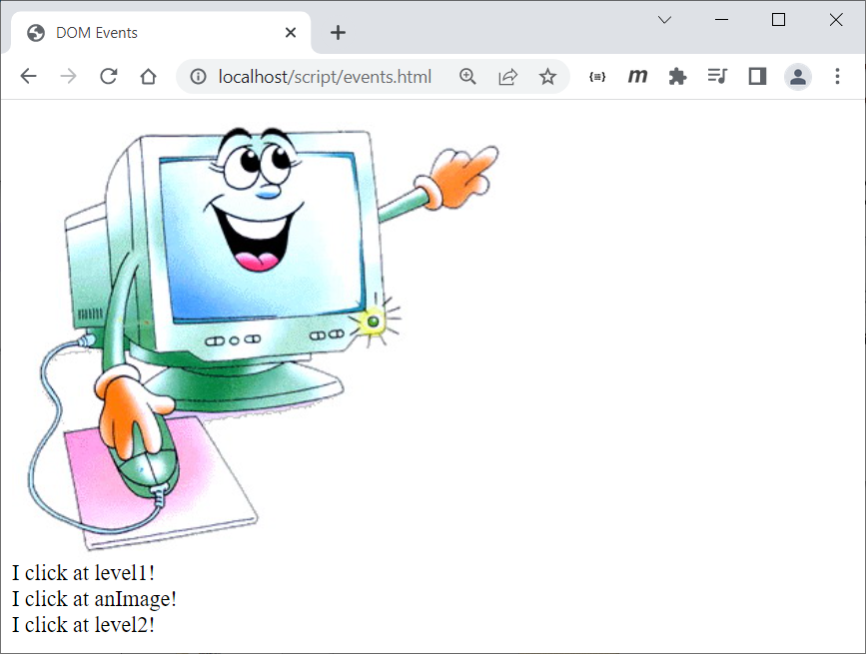
Event Flow
Event Propagation
Notes:
DOM Level 2 Model, when an event is triggered, that event is handled in three phases. These phases, in order, are called capture, target, and bubble phases.

Slide 93
Event Object
Event Properties
Type | Name | Description
DOMString | type | The name of the event (case-insensitive).
EventTarget | target | Used to indicate the EventTarget to which the event was originally dispatched.
EventTarget | currentTarget | Used to indicate the EventTarget whose EventListeners are currently being processed.
unsigned short | eventPhase | Used to indicate which phase of event flow is currently being evaluated.
boolean | bubbles | Used to indicate whether or not an event is a bubbling event.
boolean | cancelable | Used to indicate whether or not an event can have its default action prevented.
DOMTimeStamp | timeStamp | Used to specify the time (in milliseconds relative to the epoch) at which the event was created.

Slide 94
Event Object
Event Methods
Name | Argument type | Argument name | Description
stopPropagation |  |  | To prevent further propagation of an event during event flow.
preventDefault |  |  | To cancel the event if it is cancelable, meaning that any default action normally taken by the implementation as a result of the event will not occur.
initEvent | DOMString | eventTypeArg | Specifies the event type.
 | boolean | canBubbleArg | Specifies whether or not the event can bubble.
 | boolean | cancelableArg | Specifies whether or not the event's default action can be prevented.

Slide 95
Timing Event
setTimeout()
execute a code some time in the future
clearTimeout()
cancel the setTimeout()
var t=setTimeout("javascript statement",milliseconds);
clearTimeout(setTimeout_variable)

Slide 96
Timing Event
setInterval()
keeps triggering expression again and again
clearInterval()
cancel the setInterval()
var t = setInterval ( expression, interval );
clearInterval(setInterval_variable)

Slide 97
Cross Domain Communication
postMessage
to send the message
onmessage
to receive and process message
window.postMessage(msg,"*");
window.onmessage = function(e) {
console.log(e.data);
}
window.addEventListener("message",function(e) {
console.log(e.data);
});

Slide 98
Example
window – dialog.html
<html>
<head>
<title>Dialog</title>
<script>
function openWindow() {
window.open("dialog.html","my_dialog");
}
function openDialog() {
var winWidth = 500;
var winHeight = 350;
var sw = window.screen.availWidth;
var sh = window.screen.availHeight;
var wx = (sw - winWidth) / 2;
var wy = (sh - winHeight) / 2;
var features = "top="+wy+",left="+wx+",width="+winWidth+",height="+winHeight+",toobar=no,menubar=0,location=no,directories=no,status=no,scrollbars=no,resizable=yes";
var awin = window.open("dialog.html","my_window",features);
awin.opener = self;
return awin;
}
</script>
</head>
<body>
<button onclick="alert('Hello')">Alert</button>
<button onclick="confirm('Close?')">Confirm</button>
<button onclick="prompt('Input','default')">Prompt</button>
<button onclick="openWindow()">Open Window</button>
<button onclick="openDialog()">Open Dialog</button>
</body>
</html>

Slide 99
Example
CSS – dyna.html (1)
<html>
<head>
<title>DOM Style</title>
<style>
button {
border: solid #aaaaaa 1px;
color: blue;
cursor: hand;
}
textarea {
width: 400px;
height: 100px;
}
.span {
background-color: #eeeeee;
padding: 3px;
}
</style>
<script language="JavaScript">
function changeFontFamily() {
var sel = document.getElementById("ffm");
var text = document.getElementById("text");
text.style.fontFamily = sel.options[sel.selectedIndex].value;
}
function changeFontSize() {
var sel = document.getElementById("fsz");
var text = document.getElementById("text");
text.style.fontSize = sel.options[sel.selectedIndex].value+"pt";
}

Slide 100
Example
CSS – dyna.html (2)
function fontBold() {
var text = document.getElementById("text");
if(text.style.fontWeight=="bold") {
text.style.fontWeight = "normal";
} else {
text.style.fontWeight = "bold";
}
toggle();
}
function fontStyle() {
var text = document.getElementById("text");
if(text.style.fontStyle=="italic") {
text.style.fontStyle = "normal";
} else {
text.style.fontStyle = "italic";
}
toggle();
}
function textDecoration() {
var text = document.getElementById("text");
if(text.style.textDecoration=="underline") {
text.style.textDecoration = "none";
} else {
text.style.textDecoration = "underline";
}
toggle();
}

Slide 101
Example
CSS – dyna.html (3)
function toggle() {
var src = event.srcElement;
if(src.style.color!="red") {
src.style.color = "red";
} else {
src.style.color = "blue";
}
}
</script>
</head>
<body>
<span class="span">
Font: <select id="ffm" onchange="changeFontFamily()">
<option value="tahoma">Tahoma</option>
<option value="cordia new">Cordia New</option>
<option value="jasminUPC">Jasmine UPD</option>
</select>
Size : <select id="fsz" onchange="changeFontSize()">
<option value="10">10</option>
<option value="15">15</option>
<option value="20">20</option>
</select>
&nbsp;&nbsp;
<button onclick="fontBold()">bold</button>&nbsp;
<button onclick="fontStyle()">italic</button>&nbsp;
<button onclick="textDecoration()">underline</button>
</span><p>
<textarea id="text">Ajax in Practice by Dave Crane</textarea>
</body></html>

Slide 102
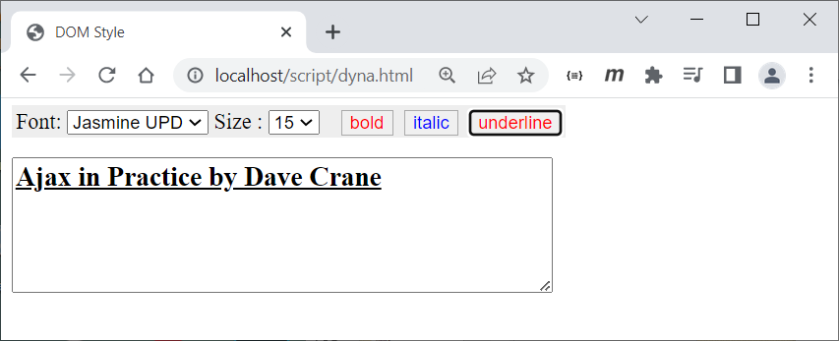
Example
CSS – dyna.html

Slide 103
Example
cross-domain – frame.html
<html>
<head>
<title>Post Message</title>
<script language="JavaScript">
function talkToFrameClick() {
msgframe.window.postMessage("Hello World", "*");
}
window.onmessage = function(e) {
console.log("on message in parent : "+e.data);
}
</script>
</head>
<body>
<button id="mybutton" onclick="talkToFrameClick()">Talk To Frame</button>
<iframe id="msgframe" name="msgframe" src="frame_msg.html" width="100%" height="100px"></iframe>
</body>
</html>

Slide 104
Example
cross-domain – frame_msg.html
<html>
<head>
<title>Post Message</title>
<script>
function sentToParent() {
window.parent.postMessage("Hello Message", "*");
}
window.onmessage = function(e) {
console.log("on message in frame : "+e.data);
mytext.value = e.data;
}
</script>
</head>
<body>
<input type="text" id="mytext" value="Hello Message"></input><br/>
<button id="mybutton" onclick="sentToParent()">Send To Parent</button>
</body>
</html>

Slide 105
JSON
JSON (JavaScript Object Notation) is a lightweight data-interchange format
It is easy for humans to read and write
It is easy for machines to parse and generate
It is based on subset of the JavaScript Programming Language
JSON is a text format that is completely language independent
JSON and ideal data-interchange language

Slide 106
JSON Structure
JSON is built on two structures
A collection of name/value pairs. In various languages, this is realized as an object, record, struct, dictionary, hash table, keyed list, or associative array
An ordered list of values. In most languages, this is realized as an array, vector, list, or sequence

Slide 107
JSON Forms
JSON take on these forms
An object is an unordered set of name/value pairs
An object begins with { (left brace) and ends with } (right brace)
Each name is followed by : (colon) and the name/value pairs are separated by , (comma)

Slide 108
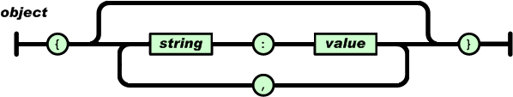
JSON Forms
Object form

Slide 109
JSON Forms
An array is an ordered collection of values.
An array begins with [ (left bracket) and ends with ] (right bracket)
Values are separated by , (comma)

Slide 110
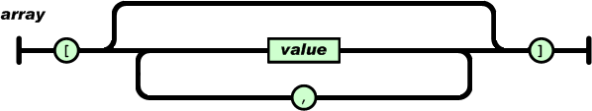
JSON Forms
Array form

Slide 111
JSON Forms
A value can be a string in double quotes, or a number, or true or false or null, or an object or an array
These structures can be nested

Slide 112
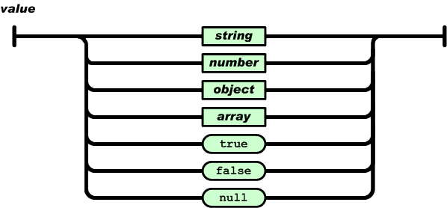
JSON Forms
Value form

Slide 113
JSON Forms
A string is a collection of zero or more Unicode characters, wrapped in double quotes, using backslash escapes
A character is represented as a single character string
A string is very much like a C or Java string

Slide 114
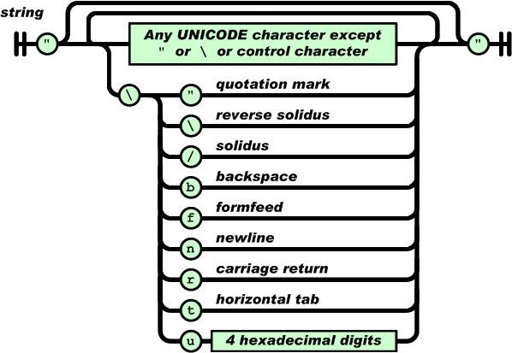
JSON Forms
String form

Slide 115
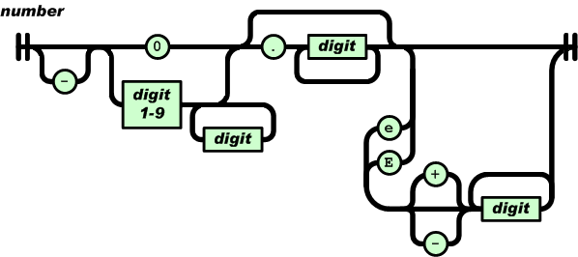
JSON Forms
A number is very much like a C or Java number, except that the octal and hexadecimal formats are not used

Slide 116
JSON In JavaScript
JSON is a subset of the object literal notation of JavaScript
This example, an object is created containing a single member “cars", which contains an array containing three objects, each containing “year", “type", and “model" members
Members can be retrieved using dot or subscript operators
var jsonObject = {"cars": [
{"year": 2001, "type": "Toyota", "model": "Corolla"},
{"year": 2002, "type": "Toyota", "model": "Vios"},
{"year": 2003, "type": "Toyota", "model": "Altis"}
]
};
jsonObject.cars[0].model // “Corolla"

Slide 117
JSON Conversion
To convert a JSON text into an object, you can use the eval() function
var jsonObject = eval('(' + jsonText + ')');

Slide 118
JSON Data Array
json01.html
<HTML>
<HEAD>
<TITLE> Test JSON</TITLE>
<script language="JavaScript">
function parseClick() {
var ary = eval('('+myinput.value+')');
var txt = "";
for(var i=0;i<ary.length;i++) {
txt += (ary[i]*5) + '<br>';
}
resultLayer.innerHTML = txt;
}
</script>
</HEAD>
<BODY>
<input type="text" id="myinput" value="[100,200,300,400,500]"></input>
<input type="button" id="jsonbtn" onclick="parseClick()" value="Parse"></input>
<div id="resultLayer"></div>
</BODY>
</HTML>

Slide 119
JSON Data Structure Array
json02.html - I
<HTML>
<HEAD>
<TITLE> Test JSON</TITLE>
<script language="JavaScript">
function parseClick() {
var ary = eval('('+mytext.value+')');
var custs = ary.CUSTOMERS;
var txt = "";
for(var i=0;i<custs.length;i++) {
txt += custs[i].CUSTOMERID + ' - ' +custs[i].NAME+' '+custs[i].SURNAME+'<br>';
}
resultLayer.innerHTML = txt;
}
</script>
</HEAD>
<BODY>
<input type="button" id="parsebtn" onclick="parseClick()" value="Parse"></input><br>

Slide 120
JSON Data Structure Array
json02.html - II
<textarea id="mytext" cols=50 rows=10>
{
"CUSTOMERS": [
{ "CUSTOMERID": "100", "NAME": "John", "SURNAME":"Doe" },
{ "CUSTOMERID": "200", "NAME": "Jane", "SURNAME":"Air" },
{ "CUSTOMERID": "300", "NAME": "Jack", "SURNAME":"Sparow" }
]
}
</textarea><br>
<div id="resultLayer"></div>
</BODY>
</HTML>

Slide 121
JSON Parameters & Arguments
json03.html
<script language="JavaScript">
var str = '{ "CUSTOMERID": “100", "NAME":“John", "SURNAME":“Doe" }’;
function displayCustomer1(custId,custName,custSurname) {
resultLayer.innerHTML = custId+" - "+custName+" "+custSurname;
}
function displayCustomer2(cust) {
resultLayer.innerHTML = cust.CUSTOMERID+" - "+cust.NAME+" "+cust.SURNAME;
}
function call1Click() {
var customer = eval('('+str+')');
displayCustomer1(customer.CUSTOMERID,customer.NAME,customer.SURNAME);
}
function call2Click() {
var customer = eval('('+str+')');
displayCustomer2(customer);
}
function call3Click() {
displayCustomer2( { CUSTOMERID:'200', NAME:'Supara', SURNAME:’Air'} );
}
</script>

Slide 122
JSON Converter
JSON Parser
Recognize only JSON text, rejecting all scripts
Faster than eval
JSON stringifier
Does not support cyclic data structures
var jsonObject = JSON.parse(jsonText, reviver);
var jsonText = JSON.stringify(jsonObject, replacer);

Slide 123
JSON Converter
json04.html
<HTML>
<HEAD>
<TITLE>Test JSON</TITLE>
<script language="JavaScript">
function parseClick() {
var jsonObj = {NAME:“John",SURNAME:“Doe"};
var jsonStr = JSON.stringify(jsonObj);
StatusLayer.innerHTML = jsonStr;
var cust = JSON.parse(jsonStr);
LogLayer.innerHTML = cust.NAME+" "+cust.SURNAME;
}
</script>
</HEAD>
<BODY>
<input type="button" value="Parse" onclick="parseClick()"><br>
<div id="StatusLayer"></div>
<div id="LogLayer"></div>
</BODY>
</HTML>

Slide 124
AJAX
Ajax is a way of developing Web applications that combines:
XHTML and CSS standards based presentation
Interaction with the page through the DOM
Data interchange with XML and XSLT
Asynchronous data retrieval with XMLHttpRequest
JavaScript to tie it all together

Slide 125
Why is AJAX
When it comes to web applications, AJAX offers two crucial advantages:
It is efficient
only a part of the web page that needs to be modified is being modified. With traditional server-side scripting you send the entire new page to the browser
It is lightweight
only small amounts of data (in the XML form) are being exchanged through the Internet, making your web applications very fast

Slide 126
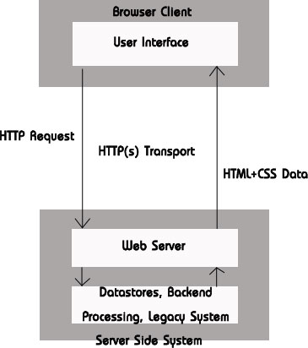
AJAX
WEB Interaction
Traditional

Slide 127
AJAX
WEB Interaction
Traditional
wait
wait
wait
Browser
work
work
work
work
Server

Slide 128
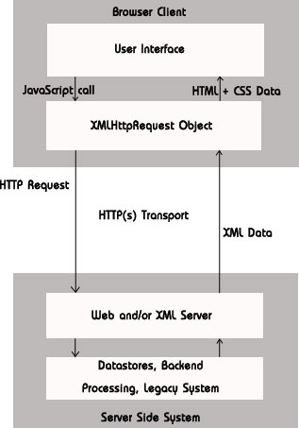
AJAX
WEB Interaction
Ajax

Slide 129
AJAX
WEB Interaction
Ajax
Browser
work
work
work
Server

Slide 130
AJAX Application Characteristics
Continuous Feel
Ajax offers a smooth ride all the way the server is only telling the screen what changed rather than having it redraw the whole screen from scratch
Real-Time Updates
Ajax application poll the server every few seconds, so it's capable of updating any information directly on the parts of the page that need changing and the rest of the page is unaffected
Graphical Interaction
Ajax represents a transition into the world of GUI controls visible on present-day desktops

Slide 131
AJAX Application
Instantiate XMLHttpRequest Object
1
Make Request to Server
2
Browser
Server
Request
Response
Parse Response on Client
3

Slide 132
AJAX Application
Instantiate
Make Request
Parse Response
var req = new XMLHttpRequest();
req.open(“GET”,”ajax/getdata.jsp”,true);
req.onreadystatechange = parseResponse;
req.send(“”);
function parseResponse() {
if (req.readyState == 4) {
if (req.status == 200) {
mydiv.innerHTML = req.responseText;
} else {
mydiv.innerHTML= " Error: "+ req.status + "\n" +req.statusText;
}
}
}

Slide 133
XMLHttpRequest Object
A JavaScript Class that lets you make asynchronous HTTP requests from JavaScript
Make an HTTP request from a JavaScript event
A call back JavaScript function is invoked at each state of the HTTP request and response

Slide 134
XMLHttpRequest Object
IE does it different
The above example however won't work on IE
req = new ActiveXOjbect("Microsoft.XMLHTTP");

Slide 135
XMLHttpRequest Object
Cross Browser Ajax
var req;
function loadXMLDoc(url) {
req = false; // branch for native XMLHttpRequest object
if(window.XMLHttpRequest) {
try {
req = new XMLHttpRequest();
} catch(e) {
req = false;
}
// branch for IE/Windows ActiveX version
} else if(window.ActiveXObject) {
try {
req = new ActiveXObject("Msxml2.XMLHTTP");
} catch(e) {
try {
req = new ActiveXObject("Microsoft.XMLHTTP");
} catch(e) {
req = false;
}
}
}
if(req) {
req.onreadystatechange = processReqChange;
req.open("GET", url, true);
req.send("");
}
}

Slide 136
XMLHttpRequest Object
Ajax Factory - I
var msHttp = new Array('Msxml2.XMLHTTP.5.0',
'Msxml2.XMLHTTP.4.0',
'Msxml2.XMLHTTP.3.0',
'Msxml2.XMLHTTP',
'Microsoft.XMLHTTP',
'Msxml.DOMDocument',
'Msxml2.DOMDocument',
'Microsoft.XMLDOM');
function AJAXFactory(){
var req;
this.HTTPRequest = function(){
if(window.XMLHttpRequest){
return new XMLHttpRequest();
}else if(window.ActiveXObject){
for(var i = 0 ; i < msHttp.length ; i++){
try{
return new ActiveXObject(msHttp[i]);
}catch(e){}
}
}
throw new Error("Could not instantiate XMLHttpRequest");
};

Slide 137
XMLHttpRequest Object
Ajax Factory - II
this.sendRequest = function(Url,Prms,HttpMethod,ProcessState){
if(req==null){
req = this.HTTPRequest();
}
if(req){
req.open(HttpMethod,Url,true);
req.onreadystatechange = function() { ProcessState(req); }
req.setRequestHeader("Content-Type", "application/x-www-form-urlencoded");
req.send(Prms);
}
return req;
}
}

Slide 138
XMLHttpRequest Object
Methods
Method | Description
abort() | Stops the current request
getAllResponseHeaders() | Returns complete set of headers (labels and values) as a string
getResponseHeader("headerLabel") | Returns the string value of a single header label
open("method", "URL"[, asyncFlag[, "userName"[, "password"]]]) | Assigns destination URL, method, and other optional attributes of a pending request
send(content) | Transmits the request, optionally with postable string or DOM object data
setRequestHeader("label", "value") | Assigns a label/value pair to the header to be sent with a request

Slide 139
XMLHttpRequest Object
Properties
Property | Description
onreadystatechange | Event handler for an event that fires at every state change
readyState | Object status integer: 0 = uninitialized 1 = loading 2 = loaded 3 = interactive 4 = complete
responseText | String version of data returned from server process
responseXML | DOM-compatible document object of data returned from server process
status | Numeric code returned by server, such as 404 for "Not Found" or 200 for "OK"
statusText | String message accompanying the status code

Slide 140
XMLHttpRequest Object
reponseXML
May not work due to the content type of the web server response
Servlet
response.setContentType(“text/xml; charset=UTF-8”);
JSP
<%@ page contentType=“text/xml; charset=UTF-8”%>
XML File
MIME in web.xml
<mime-mapping>
<extension>xml</extension>
<mime-type>text/xml</mime-type>
</mime-mapping>

Slide 141
Ajax in 10 Minutes
ajax01.html - I
<HTML>
<HEAD>
<TITLE> Test AJAX</TITLE>
<meta http-equiv="Content-Type" content="text/html ;charset=UTF-8">
<script language="JavaScript">
var objRequest = createRequestObject();
function createRequestObject() {
var objTemp = false;
if(window.XMLHttpRequest) {
objTemp = new XMLHttpRequest();
} else if(window.ActiveXObject) {
objTemp = new ActiveXObject("Microsoft.XMLHTTP");
}
return objTemp;
}

Slide 142
Ajax in 10 Minutes
ajax01.html - II
function getData() {
if(objRequest) {
objRequest.open("GET","data.txt");
objRequest.onreadystatechange = handleResponse;
objRequest.send(null);
}
}
function handleResponse() {
var objDiv = document.getElementById("targetDiv");
if(objRequest.readyState == 4 && objRequest.status == 200) {
objDiv.innerHTML = objRequest.responseText;
}
}
</script>

Slide 143
Ajax in 10 Minutes
ajax01.html – III
data.txt
</HEAD>
<BODY>
<h3>ทดสอบการดึงข้อมูลจากเซิร์ฟเวอร์โดยใช้เทคนิค AJAX</h3>
<input type="button" value="ดึงข้อมูล" onClick="getData();">
<br><br>
<div id="targetDiv">ข้อมูลจากเซิร์ฟเวอร์จะแสดงที่นี่</div>
</BODY>
</HTML>
Hello AJAX

Slide 144
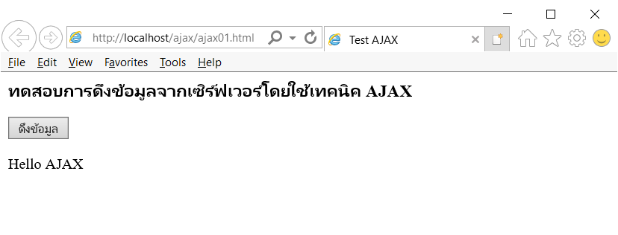
Ajax in 10 Minutes
Internet Explorer

Slide 145
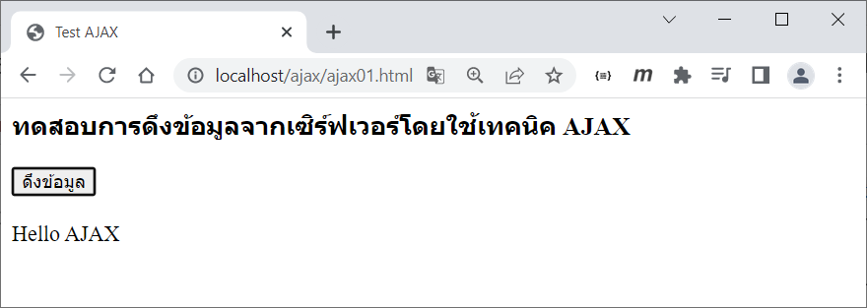
Ajax in 10 Minutes
Google Chrome

Slide 146

Ajax in 10 Minutes
Mozilla Firefox

Slide 147
Ajax with Fetch API
Fetch API provides a JavaScript for accessing and manipulating request and response
It will seem familiar to anyone who has used XMLHttpRequest
The Promise returned from fetch

Slide 148
Ajax with Fetch API
ajax02.html
<HTML>
<HEAD>
<TITLE> Test AJAX</TITLE>
<meta http-equiv="Content-Type" content="text/html;charset=UTF-8">
<script language="JavaScript">
async function getData() {
let response = await fetch("data.txt");
targetDiv.innerHTML = await response.text();
}
</script>
</HEAD>
<BODY>
<h3>ทดสอบการดึงข้อมูลจากเซิร์ฟเวอร์โดยใช้เทคนิค AJAX</h3>
<input type="button" value="ดึงข้อมูล" onClick="getData();">
<br><br>
<div id="targetDiv">ข้อมูลจากเซิร์ฟเวอร์จะแสดงที่นี่</div>
</BODY>
</HTML>

Slide 149
Reference
http://en.wikipedia.org/wiki/JavaScript
http://en.wikipedia.org/wiki/DOM_Events
https://aws.amazon.com/what-is/javascript/
http://www.w3schools.com/JS/default.asp
http://www.w3schools.com/jsref/default.asp
https://cs.brown.edu/courses/bridge/1998/res/javascript/javascript-tutorial.html
http://www.json.org/
http://json-lib.sourceforge.net/index.html
https://www.w3schools.com/js/js_ajax_intro.asp
http://www.c-point.com/javascript_tutorial/Editor/ajax_tutorial.htm
https://www.w3schools.com/jsref/api_fetch.asp
https://developer.mozilla.org/en-US/docs/Web/API/Fetch_API/Using_Fetch

Slide 150
Q & A

